Slide 1
DATA WAREHOUSING
By
Syed Bakhtawar Shah Abid
Assistant Professor
Department of Computer Science
Data Warehousing

Slide 2
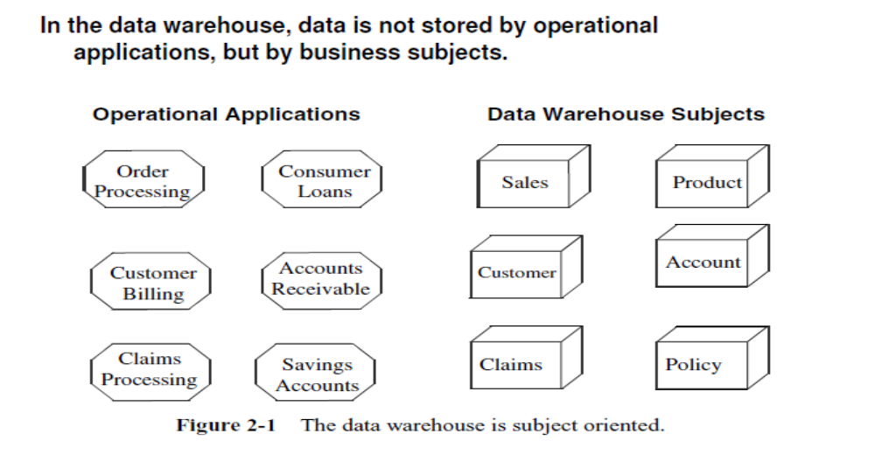
Subject Oriented Data
Data Warehousing

Slide 3
Data Warehouse Architecture
Two main architectures:
  Data Flow Architecture
    It is about how the data stores are arranged within a data warehouse and how the data flows from the source systems to the users through these data stores
  System Architecture
    It is about the physical configuration of the servers, network, software, storage, and clients
Total Slides 42
Notes:
The data flow architecture is different from data architecture. Data architecture is about
how the data is arranged in each data store and how a data store is designed to reflect the
business processes. The activity to produce data architecture is known as data modeling.

Slide 4
Data Warehouse Architecture
A data warehouse system has two main architectures:
  The data flow architecture and
  The system architecture.
Data Warehousing

Slide 5
DATA FLOW ARCHITECTURE
The data flow architecture is about
  How the data stores are arranged within a data warehouse and
  How the data flows from the source systems to the users through these data stores.
Data Warehousing

Slide 6
SYSTEM ARCHITECTURE
The system architecture is about the physical configuration of the
  Servers
  Network
  Software
  Storage and
  Clients
Data Warehousing

Slide 7
Data Flow Architecture
In data warehousing
  The data flow architecture is a configuration of data stores within a data warehouse system, along with the arrangement of how the data flows from the source systems through these data stores to the applications used by the end users.
Data Warehousing

Slide 8
Data Flow Architecture
This includes
  How the data flows are controlled
  Data flow is logged, and monitored, as well as
  The mechanism to ensure the quality of the data in the data stores
Data Warehousing

Slide 9
Data Flow Architecture
There are four data flow architectures:
  Single DDS
  NDS + DDS
  ODS + DDS, and
  Federated data warehouse.
Data Warehousing

Slide 10
Data Flow Architecture
Data stores are important components of data flow architecture.
A data store is one or more databases or files containing data warehouse data, arranged in a particular format and involved in data warehouse processes
Data Warehousing

Slide 11
Data Flow Architecture
Based on the user accessibility, DW data stores are classified into three types:
  A user-facing data store is a data store that is available to end users and is queried by the end users and end-user applications.
  An internal data store is a data store that is used internally by data warehouse components for the purpose of
    Integrating,
Data Warehousing

Slide 12
Data Flow Architecture
    Cleansing
      Data cleaning, also called data cleansing or scrubbing, deals with detecting and removing errors and inconsistencies from data in order to improve the quality of data.
    Logging, and
    Preparing data,
  it is not open for query by the end users and end-user applications.
  A hybrid data store is used for both internal data warehouse mechanisms and for query by the end users and end-user applications.
Data Warehousing

Slide 13
Data Flow Architecture
Based on the data format, the DW data stores are classified into four types:
  Stage Data Store
    A stage is an internal data store used for transforming and preparing the data obtained from the source systems, before the data is loaded to other data stores in a data warehouse.
  Normalized Data store
  Operational Data Store
  Dimensional Data Store
Data Warehousing

Slide 14
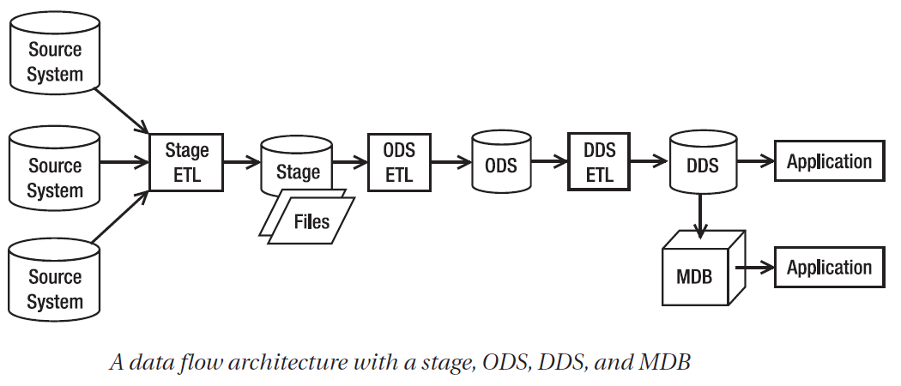
Data Flow Architecture
Data Warehousing

Slide 15
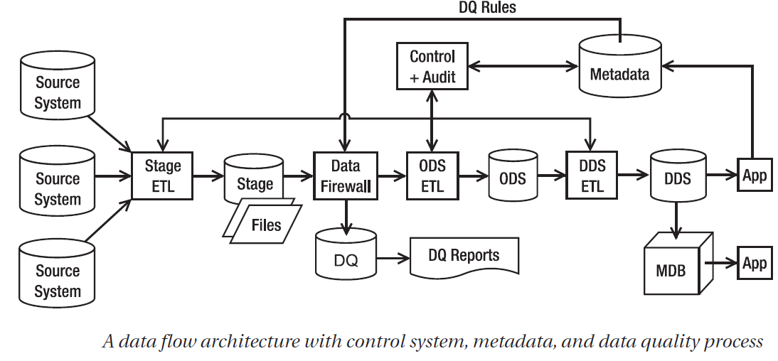
Data Flow Architecture
Data Warehousing

Slide 16
Data Flow Architecture
Four data flow architectures are
  The single DDS architecture has stage and DDS data stores.
  The NDS + DDS architecture has stage, NDS, and DDS data stores.
  The ODS + DDS architecture has stage, ODS, and DDS data stores.
  The Federated Data Warehouse (FDW) architecture consists of several data warehouses integrated by a data retrieval layer.
Data Warehousing

Slide 17
Data Flow Architecture
Single DDS
  Only two data stores:
    Stage and
    DDS
  In this architecture, the core data warehouse store is in dimensional format.
Data Warehousing

Slide 18
Data Flow Architecture
Single DDS
  In single DDS architecture, you have a one dimensional data store.
  The DDS consists of one or several dimensional data marts.
    A dimensional data mart is a group of related fact tables and their corresponding dimension tables containing the measurements of business events, categorized by their dimensions.
  An ETL package extracts the data from different source systems and puts them on the stage.
Data Warehousing

Slide 19
Data Flow Architecture
Single DDS
  A stage is a place where you store the data you extracted from the store system temporarily, before processing it further.
  A stage is necessary when
    The transformation is complex (in other words, cannot be done on the fly in a single step in memory),
    The data volume is large (in other words, not enough to be put in memory), or
    Data from several source systems arrives at different times (in other words, not extracted by a single ETL).
    You need to minimize the time to extract the data from the source system. In other words, the ETL processes dump the extracted data on disk and disconnect from the source system as soon as possible, and then at their own time they can process the data.
Data Warehousing

Slide 20
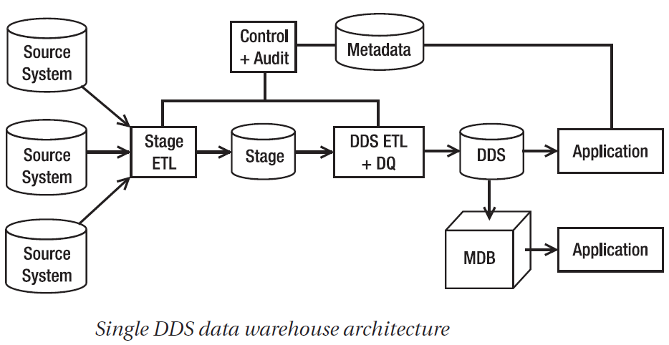
Data Flow Architecture
Data Warehousing

Slide 21
Data Flow Architecture
NDS + DDS
  In NDS + DDS data flow architecture, there are three data stores: stage, NDS, and DDS.
  This architecture is similar to the single DDS architecture, but it has a normalized data store in front of the DDS.
  The purpose of having NDS is twofold.
    First, it integrates data from several source systems.
    Second, it is able to load data into several DDSs.
  Unlike the single DDS architecture, in the NDS + DDS architecture you can have several DDSs.
Data Warehousing

Slide 22
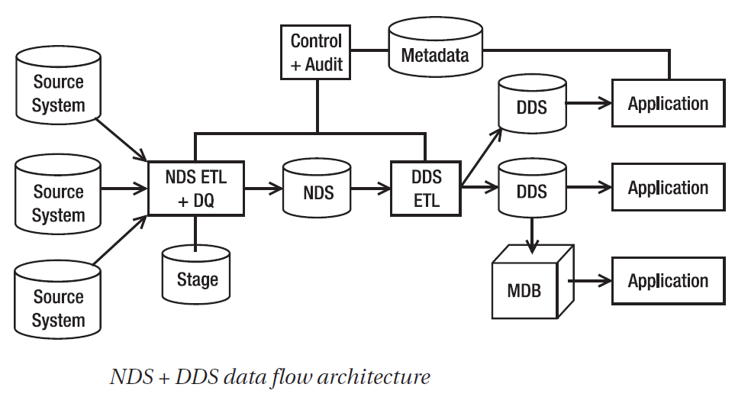
Data Flow Architecture
Data Warehousing

Slide 23
Data Flow Architecture
NDS + DDS
  NDS is the master data store, meaning NDS contains the complete data sets, including all historical transaction data and all historical versions of master data.
  NDS is an internal data store, meaning it is not accessible by the end user or the end-user applications.
  There are two types of tables in the NDS:
    Transaction tables
      A transaction table is a table that contains a business transaction business event.
    Master tables.
      A master table is a table that contains the people or objects involved in the business event.
Data Warehousing

Slide 24
Data Flow Architecture
NDS + DDS
  The NDS transaction tables are the source of data for the DDS fact table. In other words, the fact tables in the DDS are populated from the transaction tables in the NDS.
  The NDS master tables are the source of data for DDS dimension tables i.e. the dimension tables in the DDS are populated from the master tables in the NDS.
Data Warehousing

Slide 25
Data Flow Architecture
NDS + DDS
  In NDS + DDS architecture, you can have several DDSs. But there is one DDS you have to build and maintain:
  The one that contains all the fact tables and all the dimensions.
  This one is sort of obligatory
  All other DDSs are optional i.e. you build them as you need them.
Data Warehousing

Slide 26
Data Flow Architecture
ODS + DDS
  This architecture is similar to an NDS + DDS architecture, but it has an ODS in the place of the NDS.
  Like NDS, ODS is in third normal form or higher.
  Unlike the NDS, the ODS contains only the current version of master data; it has no historical master data
Data Warehousing

Slide 27
Data Flow Architecture
ODS + DDS
  The ODS integrates the data from various source systems.
  The data in the ODS is cleaned and integrated.
  The data flowing into the ODS has already passed the DQ screening.
Data Warehousing

Slide 28
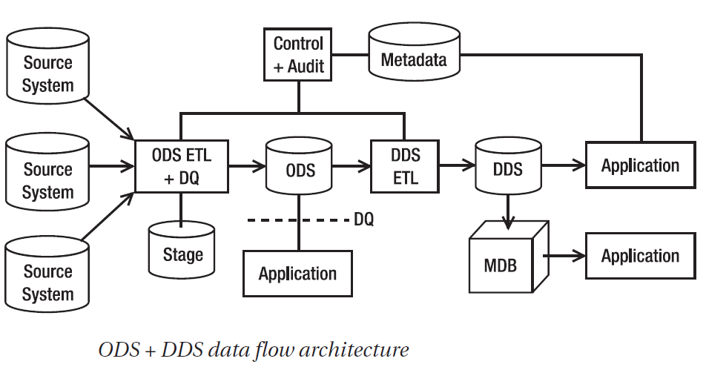
Data Flow Architecture
Data Warehousing

Slide 29
Data Flow Architecture
ODS + DDS
  Like NDS, ODS contains
  Transaction tables
    The transaction tables contain business events
  Master tables.
    The master tables contain the people or objects involved in the business events.
  The fact tables in the DDS are populated from the transaction tables in the ODS.
  The dimension tables in the DDS are populated from the master tables in the ODS.
Data Warehousing

Slide 30
Data Flow Architecture
ODS + DDS
  Unlike NDS, ODS’s master tables contain only the current version of master data. ODS does not contain the historical versions of master data.
  Unlike NDS, which is an internal data store, ODS is a hybrid data store. This means ODS is accessible by the end users and end-user applications.
Data Warehousing

Slide 31
Data Flow Architecture
ODS + DDS
  In the ODS + DDS architecture, the DDS is the master data store.
  Unlike an NDS + DDS architecture, in an ODS + DDS architecture you have only one DDS.
  The DDS contains a complete set of fact tables and the dimension tables.
  The DDS contains both the current version and all historical versions of master data.
Data Warehousing

Slide 32
Data Flow Architecture
Federated Data Warehouse (FDW)
  A federated data warehouse consists of several data warehouses with a data retrieval layer on top of them.
  A federated data warehouse retrieves data from existing data warehouses using an ETL and loads the data into a new dimensional data store.
Data Warehousing

Slide 33
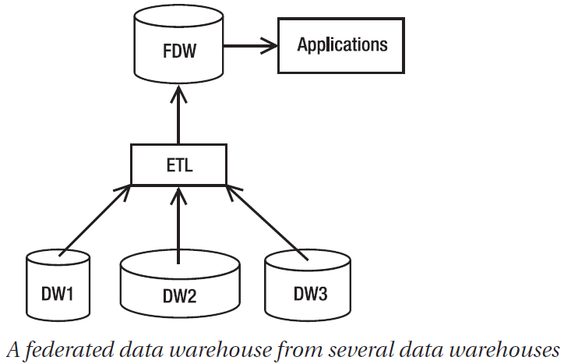
Data Flow Architecture
Data Warehousing

Slide 34
Data Flow Architecture
Federated Data Warehouse (FDW)
  The granularity of the FDW data is the same as the highest of the granularities of source data warehouses.
  If the granularities of the source data warehouses are G1, G2, and G3, then the granularity of the FDW data is the highest of (G1, G2, G3).
Data Warehousing

Slide 35
Data Flow Architecture
Federated Data Warehouse (FDW)
  This is because
  You can consolidate data only on the same granularity and
  You can transform data only from lower granularity to higher granularity, not the reverse direction.
  For example, if G1 is daily, G2 is weekly, and G3 is monthly, then the granularity of FDW is monthly.
  This is because you can transform G1 and G2 to monthly, but you cannot transform G3 to daily or weekly.
Data Warehousing

Slide 36
Data Flow Architecture
Federated Data Warehouse (FDW)
  The number of subject areas in the FDW is probably narrower than the number of subject areas in the source DWs.
  This is because the FDW is at a higher level than the source DWs, and at this level, not all subject areas are applicable and useful for the business users.
    For example, in the global data warehouse, you may be interested in sales and employees and leave inventory and campaigns in the regional data warehouses.
Data Warehousing

Slide 37
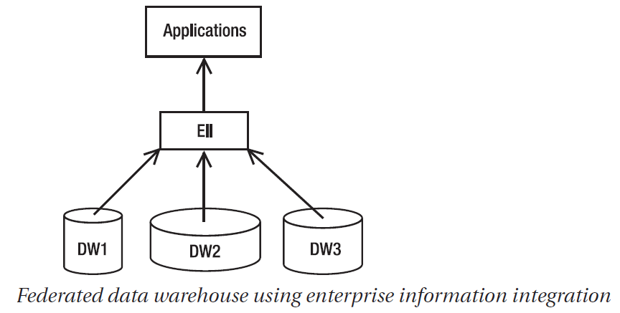
Data Flow Architecture
Data Warehousing

Slide 38
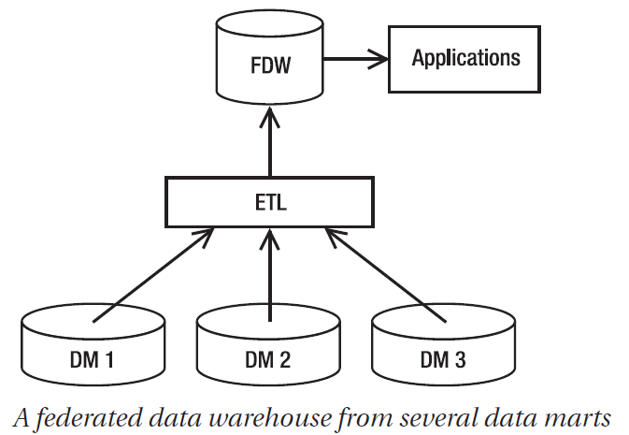
Data Flow Architecture
Data Warehousing

Slide 39
System Architecture
Once a certain data flow architecture is chosen, the system architecture needs to be designed which is the physical arrangement and connections between the servers, network, software, storage system, and clients.
Data Warehousing

Slide 40
System Architecture
Designing a system architecture requires knowledge about
  Hardware (especially servers)
  Networking (especially with regard to security and performance and in the last few years also fiber networks), and
  Storage (especially storage area networks, RAID, and automated tape backup solutions).
Data Warehousing

Slide 41
System Architecture
RAID Acronym for redundant array of independent (or inexpensive) disks.
A data storage method in which data is distributed across a group of computer disk drives that function as a single storage unit.
All the information stored on each of the disks is duplicated on other disks in the array.
This redundancy ensures that no information will be lost if one of the disks fails.
Data Warehousing

Slide 42
System Architecture
RAID is generally used on network servers where data accessibility is critical and fault tolerance is required.
There are various defined levels of RAID, each offering differing trade-offs among access speed, reliability, and cost
RAID levels
  RAID 0
  RAID 1
  RAID 5
  RAID 1 + 0 (Some people call it RAID 10)
Data Warehousing

Slide 43
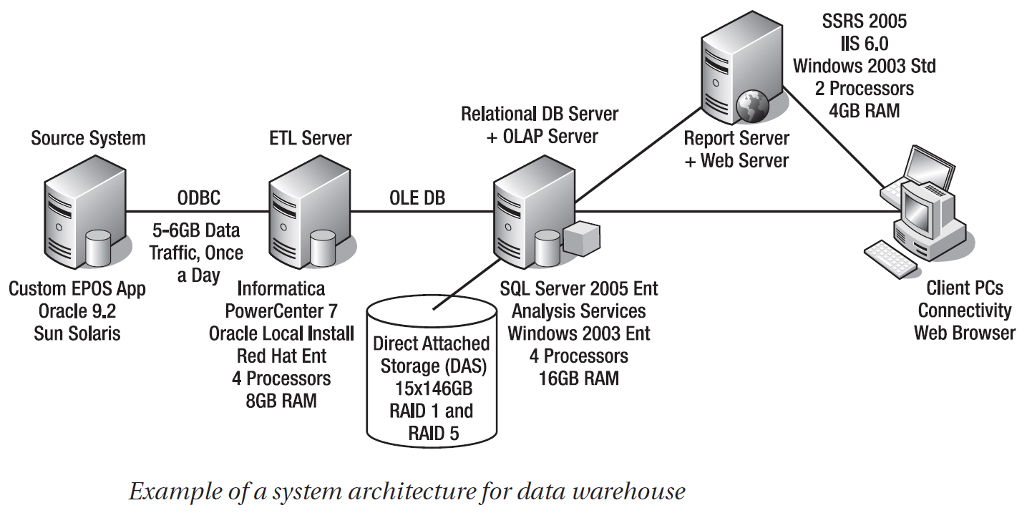
System Architecture
Data Warehousing

Slide 44
System Architecture
In this example, the system architecture consists of three servers:
  One ETL server
  One database server, and
  One reporting server as SSRS (SQL Server Reporting Services).
The source system is an electronic point-of-sale system that records retail sales in the stores running on Oracle 9.2 on Sun Solaris.
Data Warehousing

Slide 45
System Architecture
The ETL server is Informatica PowerCenter 7 installed on Red Hat Enterprise Linux.
The data warehouse data stores (stage, DDS, and MDB) are hosted in the SQL Server relational database engine and Analysis Services, running on Windows Server 2003.
The data is physically stored in a DAS consisting of fifteen 146GB disks, making the raw capacity 2TB.
The disks are configured in RAID 1 and RAID 5 for data resilience.
Data Warehousing

Slide 46
System Architecture
The following SQL Server’s services are used to build a DW using SQL Server.
  SSIS (SQL Server Integration Services) for the ETL tool,
  SSRS (SQL Server Reporting Services) for reporting and
  SSAS (SQL Server Analysis Services) for OLAP and data mining.
Data Warehousing

